Slide 1
Light Pre-Pass
-Deferred Lighting: Latest Development-
by Wolfgang Engel
August 3rd, 2009

Slide 2
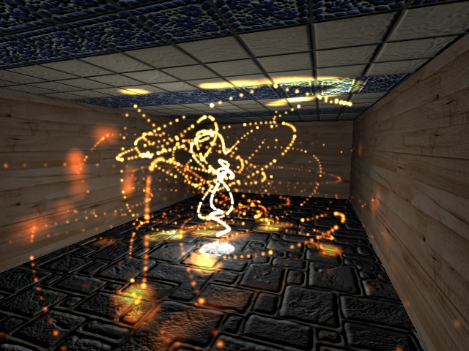
Screenshot

Slide 3
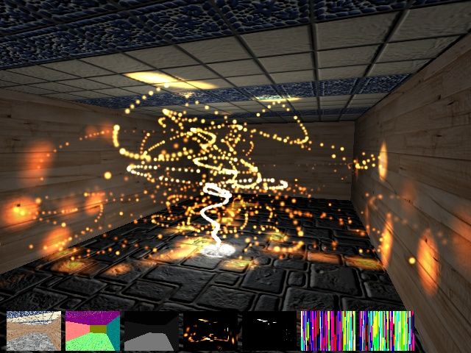
Screenshot

Slide 4
Agenda
Rendering Many Lights History
Light Pre-Pass (LPP)
LPP Implementation
    Efficient Light rendering on DX8, 9, 10, 11 and PS3 hardware
    Balance Quality / Performance
MSAA Implementation on DX 10.0, 10.1, XBOX 360, 11 and PS3 hardware

Slide 5
Rendering Many Lights History
Forward / Z Pre-Pass rendering
  Re-render geometry for each light -> lots of geometry throughput (still an option on older hardware)
  Write pixel shader with four or eight lights -> draw lights per-object -> need to split up geometry following light distribution
  Store light properties in textures and index into this texture -> dependent texture look-up and lights are not fully dynamic

Slide 6
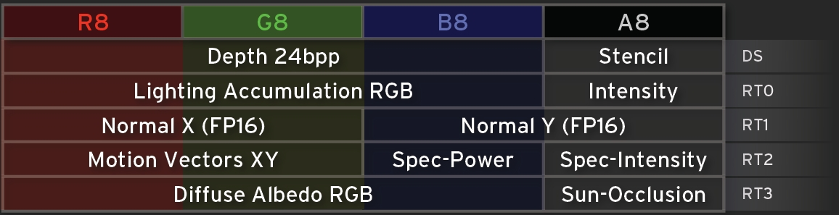
Rendering Many Lights History
Deferred Shading / Rendering
Split up rendering into a geometry pass and a lighting pass -> makes lights independent from geometry
Geometry pass stores all material and light properties
Killzone 2’s G-Buffer Layout (courtesy of Michal Valient)

Slide 7
Rendering Many Lights History
Deferred Shading / Rendering
Render opaque objects
Transparent objects
Normals
Specular /
Motion Vec
Albedo /
Shadow
Depth Buffer
Deferred
Lighting
Switch off depth write
Forward
Rendering
Sort Back-To-Front

Slide 8
Rendering Many Lights History
Advantages:
  Only one geometry pass for the main view (probably more than a dozen for other views like shadows, reflections, transparent objects etc.)
  Lights are blit and therefore only limited by memory bandwidth
Disadvantages:
  Memory bandwidth (reading four render targets for each light)
  Recalculate full lighting equation for every light
  Limited material representation in G-Buffer
  MSAA difficult compared to Forward Renderer

Slide 9
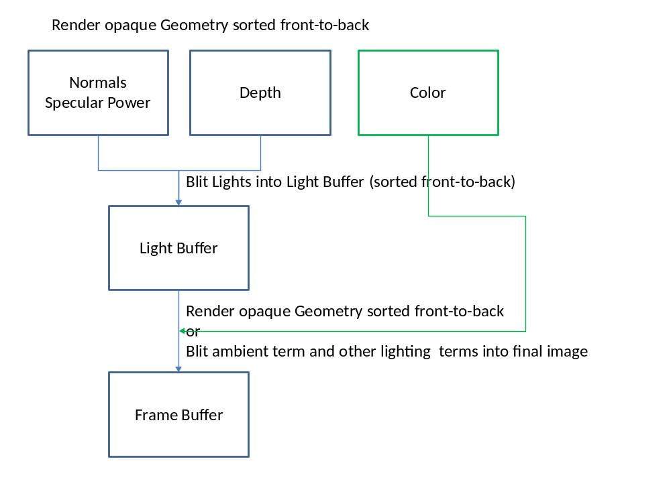
Light Pre-Pass
Light Pre-Pass / Deferred Lighting

Slide 10
Light Pre-Pass
Version A:
  Geometry pass: fill up normal and depth buffer
  Lighting pass: store light properties in light buffer
  2. Geometry pass: fetch light buffer and apply different material terms per surface by re-constructing the lighting equation

Slide 11
Light Pre-Pass
Version B (similar to S.T.A.L.K.E.R: Clear Skies [Lobanchikov]):
  Geometry pass: fill up normal + spec. power and depth buffer and a color buffer for the ambient pass
  Lighting pass: store light properties in light buffer
  Ambient + Resolve (MSAA) pass: fetch light buffer use its content as diffuse and specular content and add the ambient term while resolving into the main buffer

Slide 12
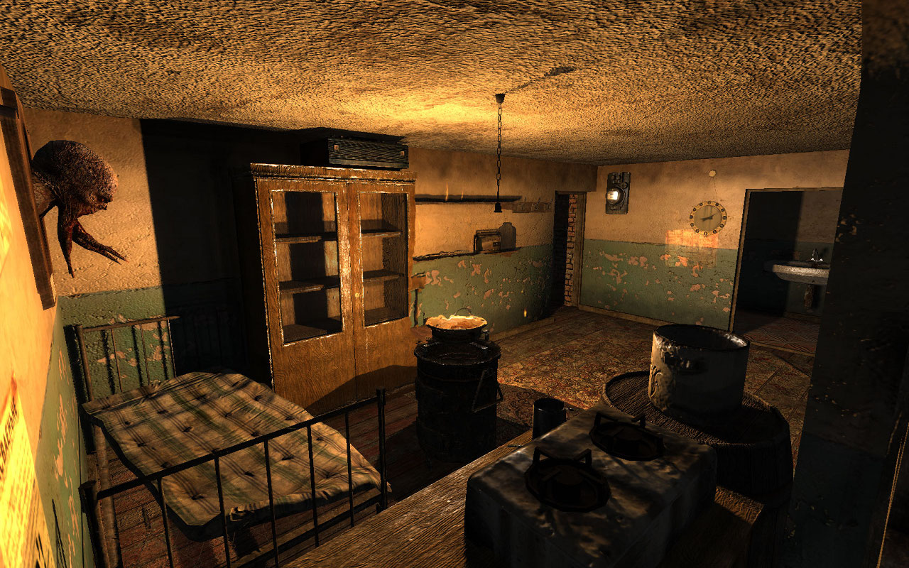
Light Pre-Pass
S.T.A.L.K.E.R: Clear Skies

Slide 13
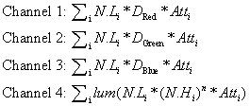
Light Pre-Pass
Light Properties that are stored in light buffer
Light buffer layout
Dred/green/blue is the light color
Notes:
Because luminance is a linear function of RGB, accumulating luminance fulfills the requirement that the sum of all luminance values equals to the luminance of the sum of all specular contributions.

Slide 14

Light Pre-Pass
Specular stored as luminance
Reconstructed with diffuse chromacity

Slide 15
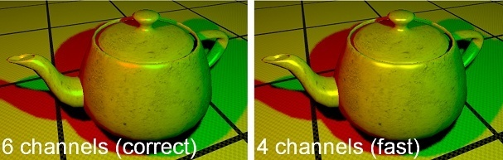
Light Pre-Pass
CryEngine 3: On the right the approx. specular term of the light buffer and on the left
a correct specular term with its own specular color (courtesy of Martin Mittring)

Slide 16
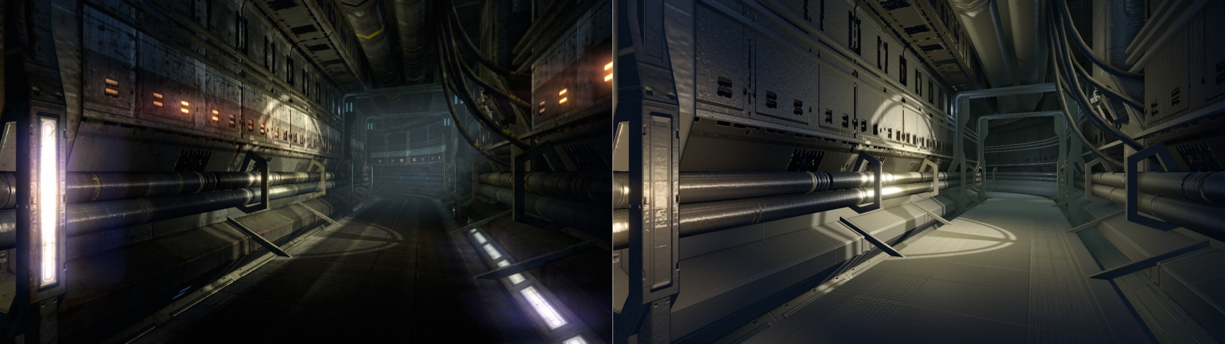
Light Pre-Pass
CryEngine 3: On the right the approx. specular term of the light buffer and on the left
the final image (courtesy of Martin Mittring)

Slide 17
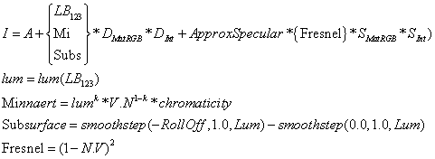
Light Pre-Pass
Advantage of Version A: offers more material variety
Version B faster: does not need to render scene geometry a second time

Slide 18
Light Pre-Pass Implementation
Memory Bandwidth Optimizations (DirectX 9)
  Depth-fail Stencil lights: render light volume in stencil and then blit light [Hargreaves][Valient]
  Geometry lights: render bounding geometry -> never get inside light -> avoid depth func change [Thibieroz04]
  Scissor lights: construct scissor rectangle from bounding volume and set it [Placeres] (PS3: depth bound testing ~ scissor in 3D)
  Batched lights: sort lights by size, x and y position in screenspace. Render close lights in batches of 4, 8, 16
Distance from Camera

Slide 19
Light Pre-Pass Implementation
Memory Bandwidth Optimizations (DirectX 10, 10.1, 11)
  GS bounding box: construct bounding box in geometry shader
  Implement lighting with the compute shader
Memory Bandwidth Optimizations (DirectX 8)
  Same as DirectX 9 if supported
  Re-render geometry per light as alternative

Slide 20
Light Pre-Pass Implementation
Memory Bandwidth Optimizations (PS3)
Full GPU solution [Lee]: like DirectX9 with depth buffer access and depth bounds testing + batched light support
SPE (Synergistic Processing Element) + GPU solution [Palestra] : divide light buffer in tiles:
  Cull tile frustum against light frustum on SPE and keep track of which light goes into which tile
  Render lights in batches per tile on GPU into light buffer
Full SPE solution [Swoboda][Tovey]: like 2 a) but render lights in batches on the SPE into the light buffer

Slide 21
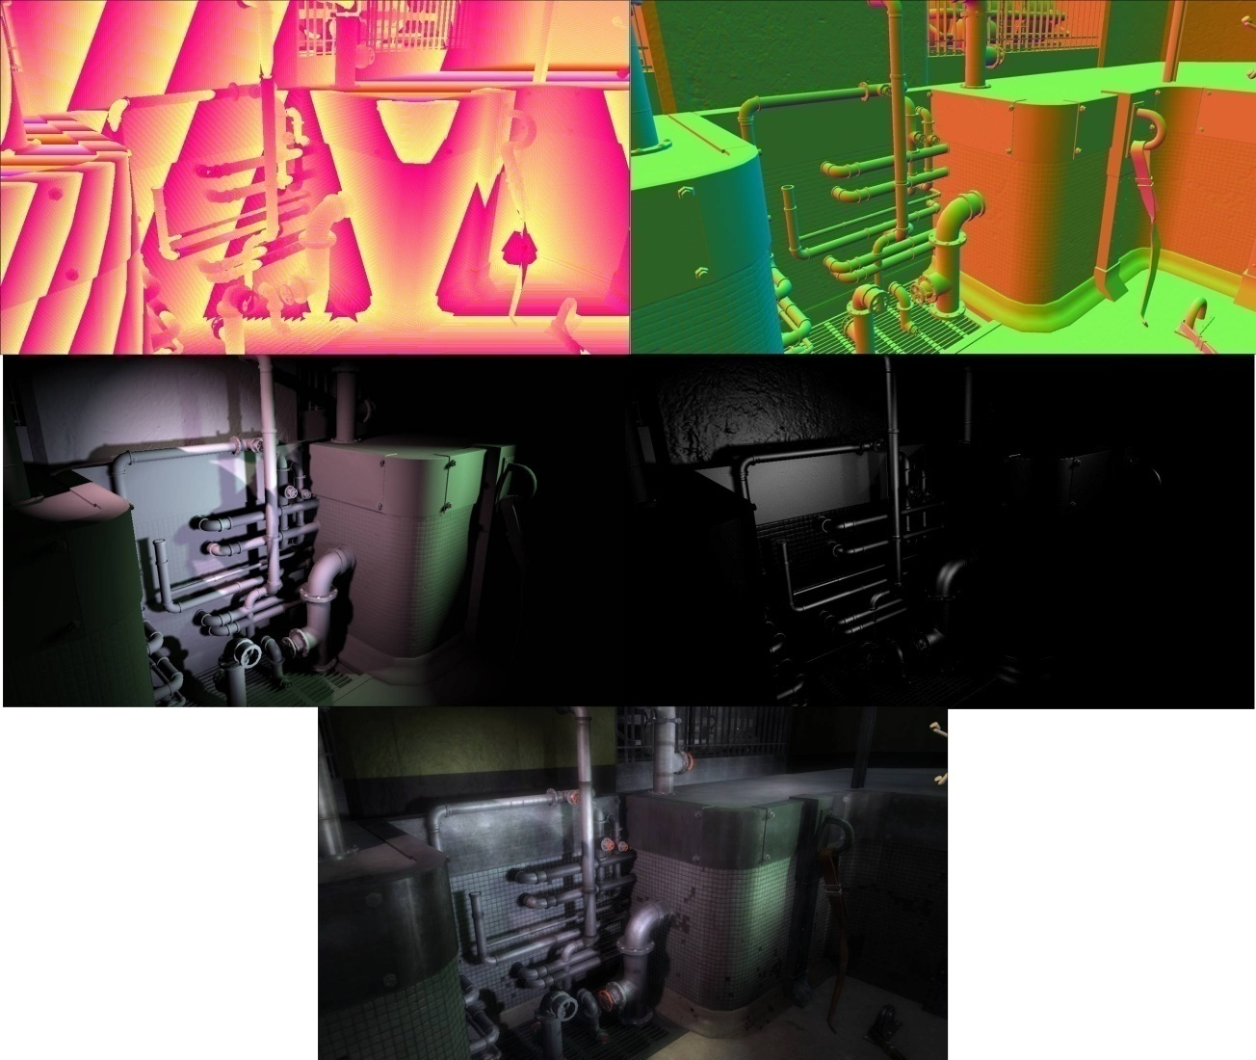
Light Pre-Pass Implementation
Resistance 2TM in-game screenshot; first row on the left is the depth buffer, on the right is the normal buffer; in the second row is the diffuse light buffer and on the right is the specular light buffer; in the last row is the final result.

Slide 22
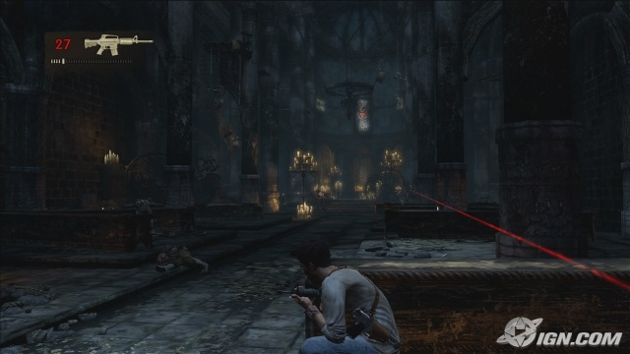
Light Pre-Pass Implementation
UnchartedTM in-game screenshot

Slide 23
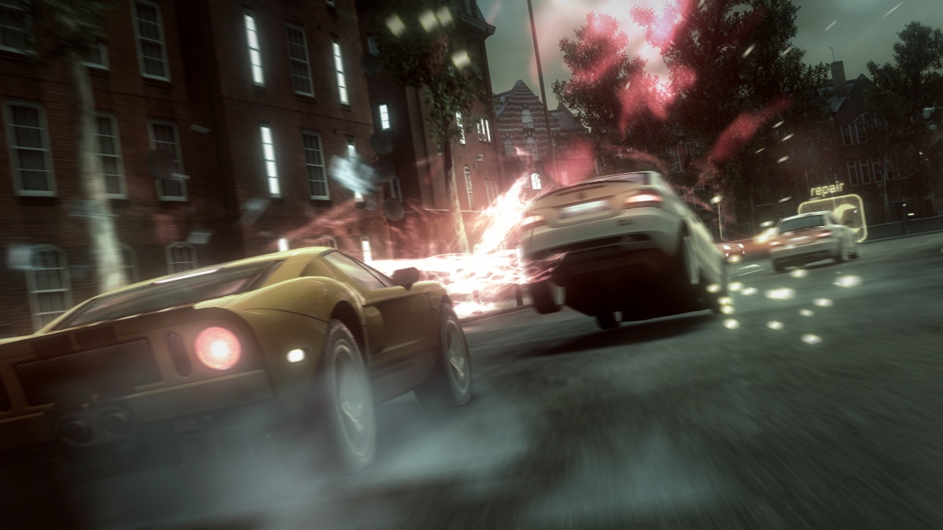
Light Pre-Pass Implementation
BlurTM in-game screenshot

Slide 24
Light Pre-Pass Implementation
    Balance Quality / Performance
      Stop rendering dynamic lights after a certain range for example 40 meters and render glow cards instead
      Use smaller light buffer for distant lights and scale up

Slide 25
Light Zoning
Advanced interzone lighting analysis [Lengyel]
Problem: e.g. light shines on other side of wall on the floor
-> have special light types that deal with the problem like a 180 degree spotlight; artists have to place this

Slide 26
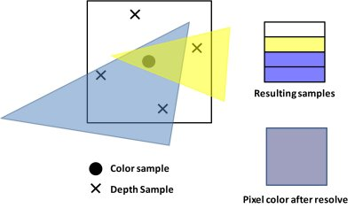
MSAA
Multisample Anti-Aliasing (courtesy of Nicolas Thibieroz)

Slide 27
MSAA
LPP Version A
  Geometry pass: render into MSAA’ed normal and depth buffer
  Lighting pass (ideal world): render by reading each sample in the MSAA’ed buffer and write into each sample in the MSAA’ed light buffer
  Second Geometry pass: render geometry into MSAA’ed accumulation buffer by reading the MSAA’ed light buffer, depth and normal buffer and re-constructing the lighting equation
  Resolve: into main buffer

Slide 28
MSAA
LPP Version B
  Geometry pass: render into MSAA’ed normal, depth and color buffer
  Lighting pass (ideal world): render by reading each sample in the MSAA’ed buffer and write into a sample in the MSAA’ed light buffer
  Ambient pass: resolve light buffer and color buffer into main buffer by adding the ambient term

Slide 29
MSAA
Lighting pass: MSAA lighting is required e.g. one sample is covered by a green light and three by a red light
Per sample is expensive- > optimize by detecting polygon edges
  Run screen-space edge detection filter with normal and/or depth buffer
  Or use centroid sampling

Slide 30
MSAA
Store result in stencil buffer
Two shaders:
  run the per-sample shader only on edges
  rest -> run per-pixel shader
// if MSAA is used
for (int p = 0; p < 2; p++)
{
…
renderer->setDepthState(stencilTest, (p == 0)? 0x1 : 0x0);
renderer->setShader(lighting[p]);
…
}

Slide 31
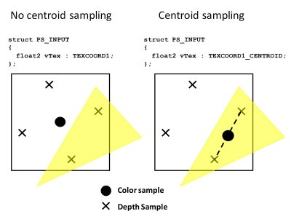
MSAA
Centroid Sampling Trick:
Edge detection with centroid sampling (courtesy of Nicolas Thibieroz)

Slide 32
MSAA
Centroid Sampling Trick II
  Sample without and with centroid sampling -> find out if the second sample coordinate is offset [Thieberoz]
  Check the fractional part of the position value if it equals 0.5 -> no polygon edge [Persson]

Slide 33
MSAA
Centroid sampling Trick III:
Disclaimer:
  Probably only works with 2xMSAA
  PC Hardware might return the center point for 4xMSAA [Shishkovtsov]

Slide 34
MSAA
…
// shader that fills the G-Buffer
struct PsIn
{
centroid float4 position : SV_Position;
…
};
// find polygon edge with centroid sampling
Out.base.a = dot(abs(frac(In.position.xy) - 0.5), 1000.0);
// shader that resolves the color buffer with the edge data in alpha
// resolve color buffer and write out 1 into a non-MSAA’ed render target
return (base.a > 0.0);
// shader that creates the stencil buffer mask
clip(BackBuffer.Sample(filter, In.texCoord).a - 0.5);
…

Slide 35
MSAA
DirectX 10.1, 11, XBOX 360: execute pixel shader per sample
struct PsIn
{
…
uint uSample : SV_SAMPLEINDEX; // Sample frequency
};
float4 PSLightPass_EdgeSampleOnly(PsIn In) : SV_TARGET
{
// Sample GBuffers
C = Color.Load( nScreenCoordinates, In.uSample);
Norm = Normal.Load( nScreenCoordinates, In.uSample);
D = Depth.Load( nScreenCoordinates, In.uSample);
// extract data from GBuffers
//…
// do the lighting
return LightEquation(…);
}

Slide 36
MSAA
DirectX 9:
  Can’t run shader at sample frequency or support of mask
  no MSAA’ed depth buffer read and write
DirectX 10
  Can write with a mask into samples and read from samples -> shader runs per-pixel
  No MSAA’ed depth buffer read and write officially (maybe if you ask your hardware support engineer ☺)

Slide 37
MSAA
PS3
Full GPU solution:
  Use write mask to write into each sample per-pixel
  Use edge detection to fill up stencil buffer and run per-sample only on the edges (stencil buffer is after pixel shader -> not very effective)
SPE + GPU solution: same as 1.
Full SPE solution [Swoboda]: use SPE to render per-sample

Slide 38
Future
The story of the Light Pre-Pass / Deferred Lighting is still not fully written and there are many things waiting to be discovered in the future …

Slide 39
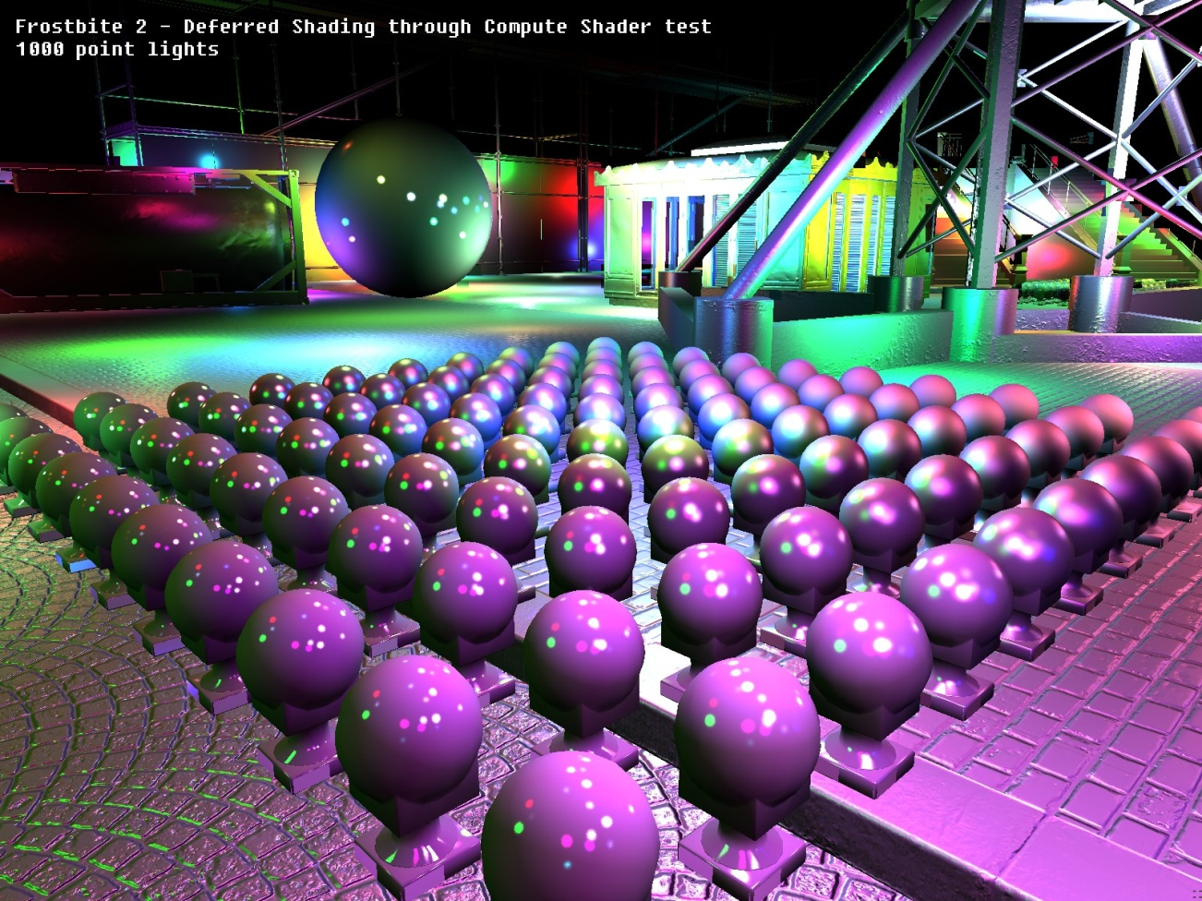
Future
Compute Shader Implementation
Johan Andersson, DICE -> check out the Beyond Programmable Shading course

Slide 40
Acknowledgements
Nathaniel Hoffmann
Nicolas Thibieroz
Matt Swoboda
Steven Torvey
Michael Krehan
Emil Persson
Martin Mittring
Mark Lee
Peter Santoki
Allan Green
Stephen Hill

Slide 41
Thank you
wolfgang.engel@gmail.com

Slide 42
References
[Hargreaves] Shawn Hargreaves, “Deferred Shading”, http://www.talula.demon.co.uk/DeferredShading.pdf
[Lobanchikov] Igor A. Lobanchikov, “ GSC Game World‘s S.T.A.L.K.E.R : Clear Sky – a showcase for Direct3D 10.0/1”, http://developer.amd.com/gpu_assets/01GDC09AD3DDStalkerClearSky210309.ppt
[Mittring] Martin Mittring, “A bit more Deferred – Cry Engine 3”, http://www.slideshare.net/guest11b095/a-bit-more-deferred-cry-engine3
[Lee] Mark Lee, “Resistance 2 Prelighting”, http://www.insomniacgames.com/tech/articles/0409/files/GDC09_Lee_Prelighting.pdf
[Lengyel] Eric Lengyel, “Advanced Light and Shadow Culling Methods”, http://www.terathon.com/lengyel/#slides
[Placeres] Frank Puig Placeres, “Overcoming Deferred Shading Drawbacks,” pp. 115 – 130, ShaderX5
[Shishkovtsov] Oles Shishkovtsov, “Making some use out of hardware multisampling”; http://oles-rants.blogspot.com/2008/08/making-some-use-out-of-hardware.html
[Swoboda] Matt Swoboda, “Deferred Lighting and Post Processing on PLAYSTATION®3, http://research.scee.net/presentations
[Tovey] Steven J. Tovey, Stephen McAuley, “Parallelized Light Pre-Pass Rendering with
the Cell Broadband EngineTM”, to appear in GPU Pro – Advanced Rendering Techniques,
AK Peters, March 2010.
[Thibieroz04] Nick Thibieroz, “Deferred Shading with Multiple-Render-Targets,” pp. 251 – 269, ShaderX2 – Shader Programming Tips & Tricks with DirectX9
[Thibieroz] Nick Thibieroz, “Deferred Shading with Multisampling Anti-Aliasing in DirectX 10” , ShaderX7 – Advanced Rendering Techniques, pp. ??? - ???
[Valient] Michael Valient, “Deferred Rendering in Killzone 2,” www.guerillagames.com/publications/dr_kz2_rsx_dev07.pdf

